Slide 1
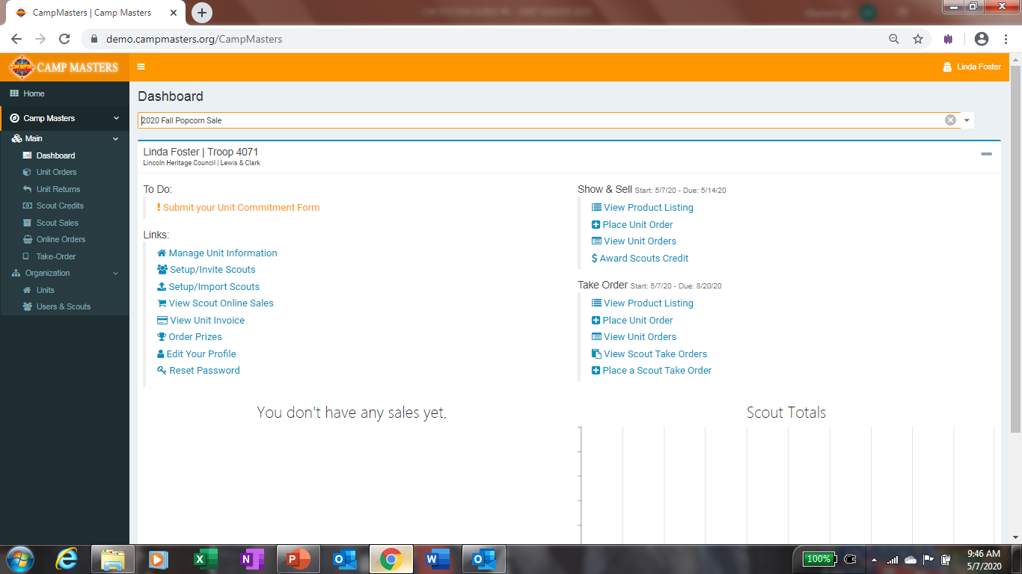
CM SYSTEM GUIDE #4 – UNIT LEADERS
COUNCIL WILL EMAIL TO UNIT LEADER A “SINGLE-SIGN ON LINK. USE THE LINK TO ACCESS THE ORDERING SYSTEM.
OR
ACCESS VIA WWW.CAMPMASTERS.ORG; see bottom left on screen “Council/Units/Scouts Log In Here”. YOUR UNIQUE EMAIL WILL BE YOUR LOG-IN. CLICK ON FORGOT PASSWORD AT BOTTOM OF LOGIN BOX. ENTER YOUR EMAIL ON NEXT SCREEN TO SEND A SET UP PASSWORD LINK TO YOUR EMAIL.
** use Google Chrome or Firefox Web Browser

Slide 2
Step 1 - Commit to sale/update contact info
Place Unit S&S Order See pg. 8
Step 2 – Setup Scouts Individually pg. 7 for instructions. OR Click Setup/Import Scouts to Import all Scouts. See pg. 4–6 for instructions.
Place Unit Take Order See pg. 8
Step 3 – Click Setup/Invite Scouts to send sign-on link. See pg. 7. NOTE: Scouts must have a UNIQUE email address to access the system.

Slide 3
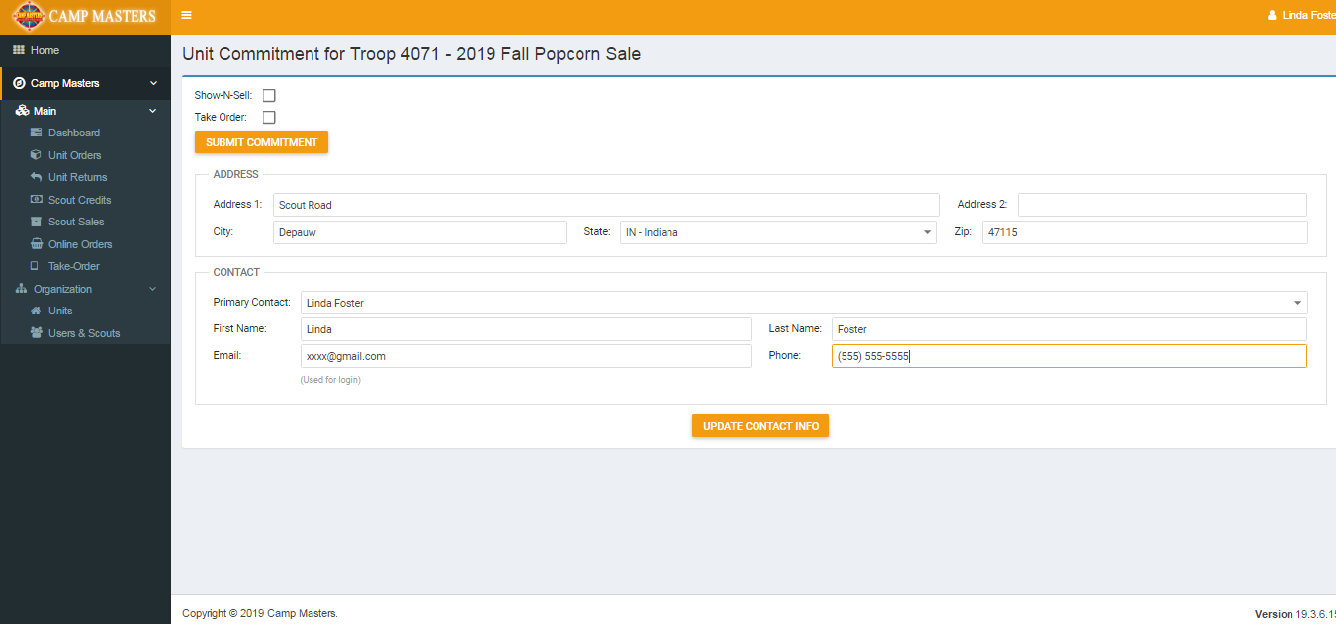
Select Sale Type(s); click “Submit Commitment
Update contact info; click “Update Contact Info” and return to Dashboard.

Slide 4
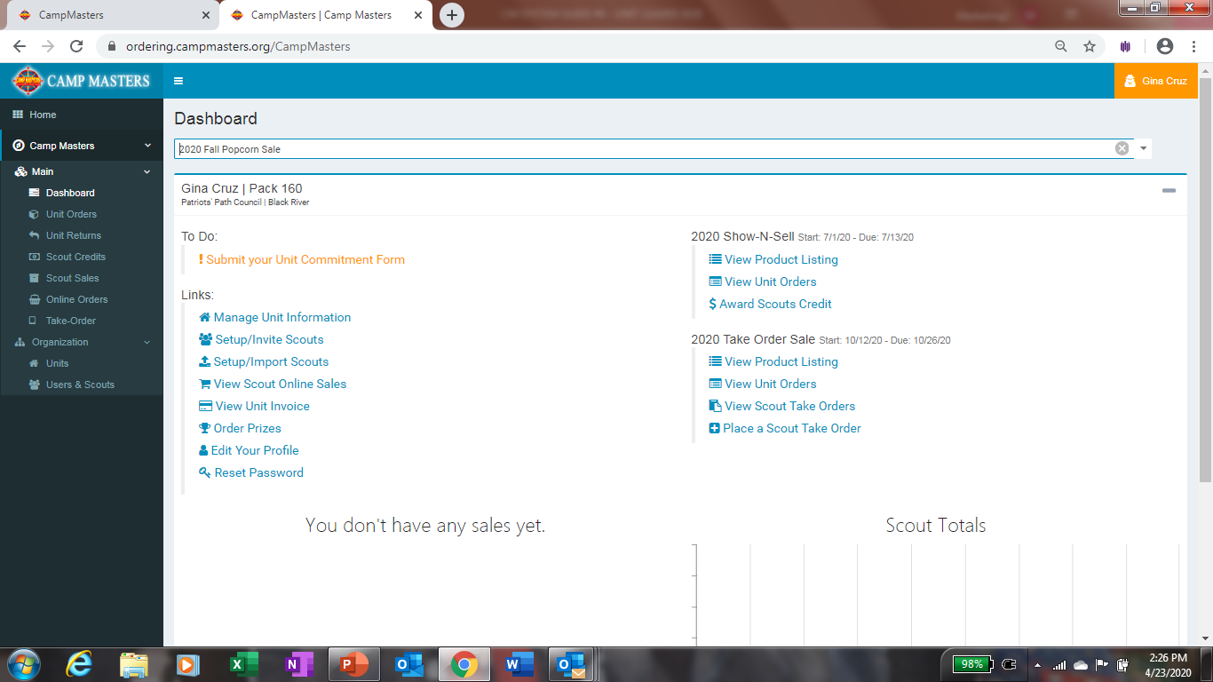
To Import Scouts, click on “Setup/Import Scouts”

Slide 5
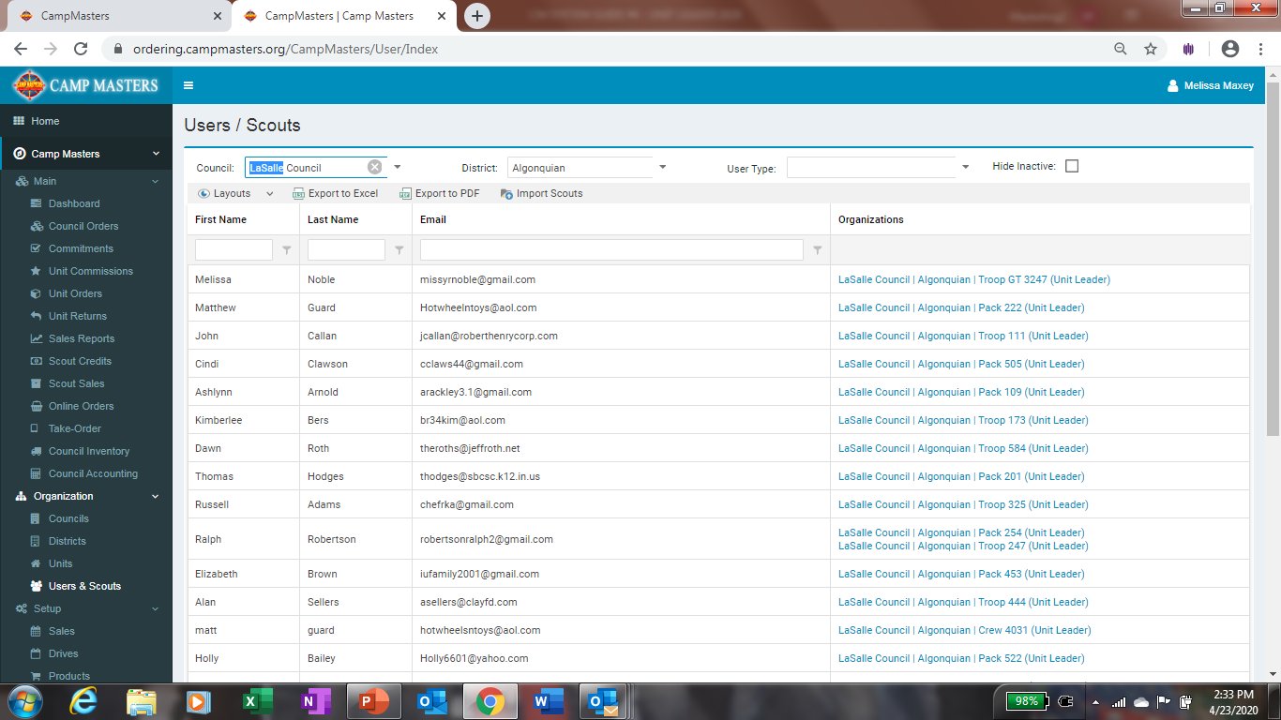
Click on Import Scouts above.
NOTE: Scouts must have a UNIQUE email address to access the system.

Slide 6
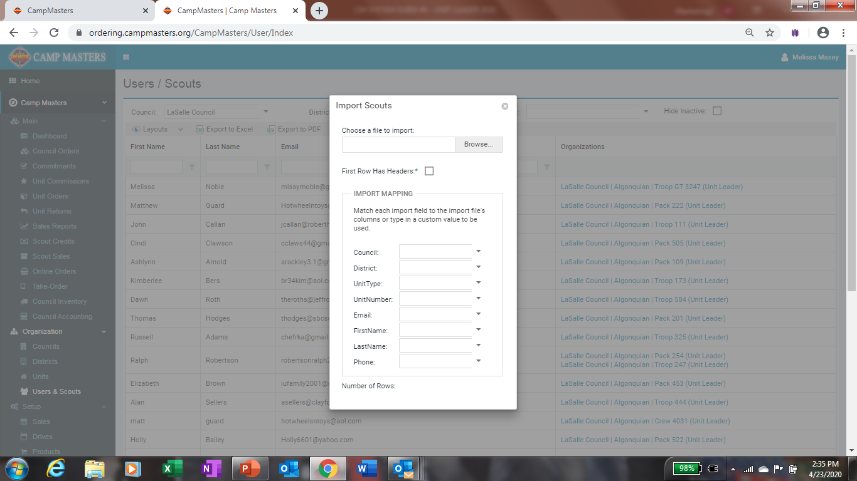
You will need to create an excel spreadsheet with Headers to match the Import template to upload your Scouts. Once your template is completed, click on Browse to select your excel file. Click “First Row Has Headers” on Import Scouts form. Click the down arrow for Council and select your header “Council” it will populate your Council Name. Continue until all information is on the Import Scouts form. This will open up where you can then click “Upload”

Slide 8
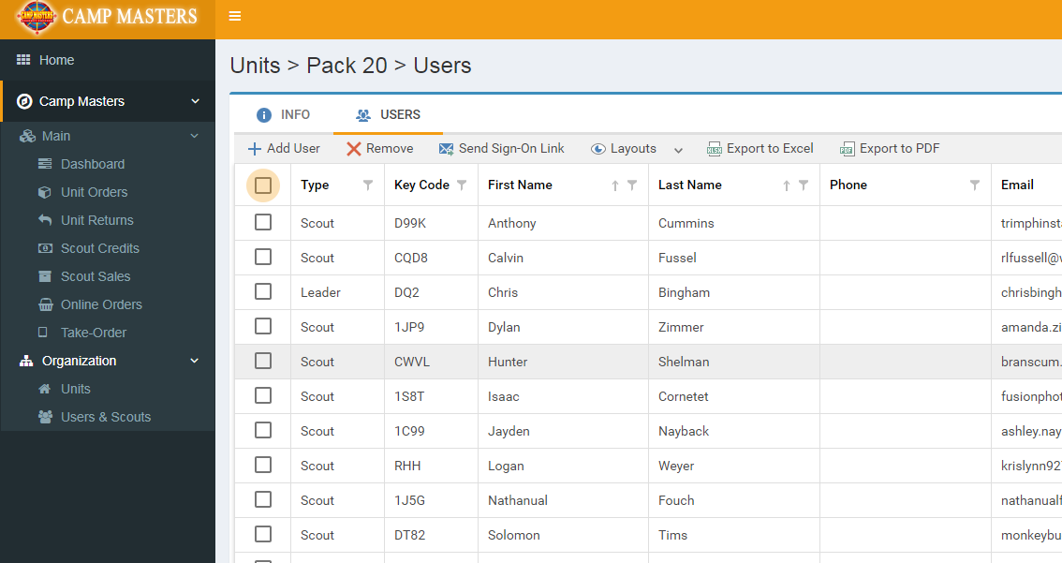
Step 2 – Setup/Invite Scouts – From this page, send Sign-on Link to all Scouts or select Scouts by clicking on box to check mark.
Step 3 - Click on “+Add User” for new Scouts. Click “Remove” to remove inactive Scouts. Click on any Scout to update information.
EACH SCOUT MUST HAVE A UNIQUE, ACTIVE EMAIL TO ACCESS THE CM SYSTEM.

Slide 9
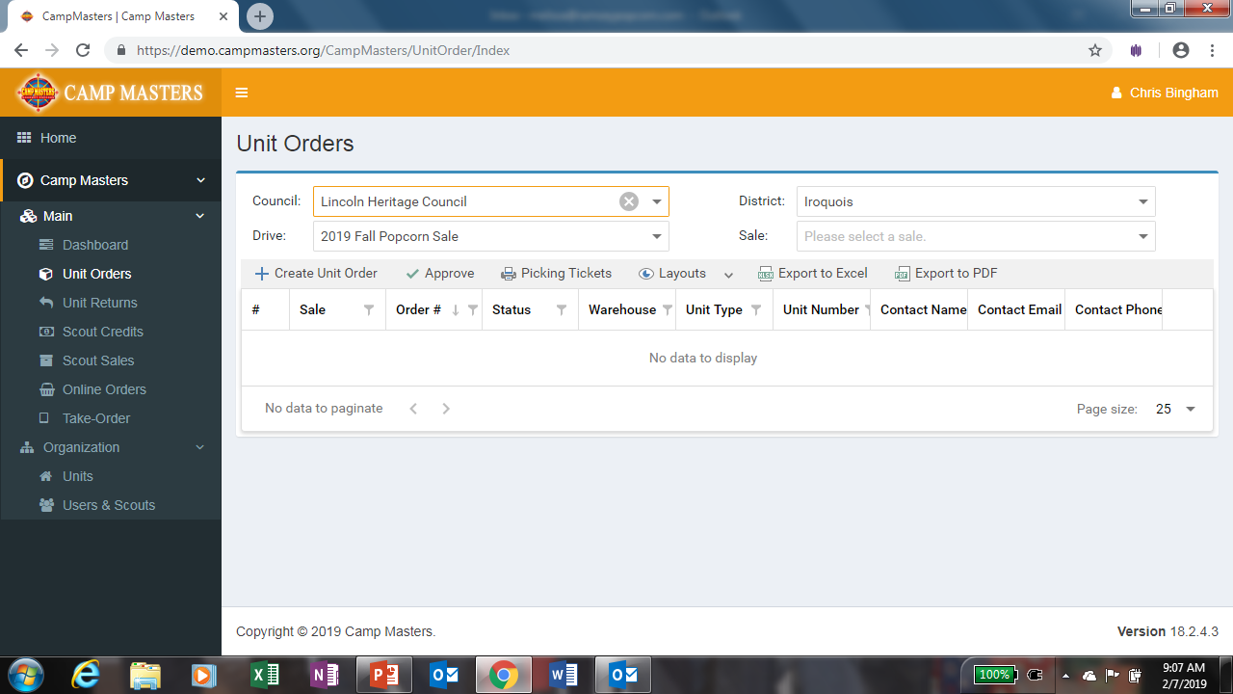
Click “Create Unit Order

Slide 10
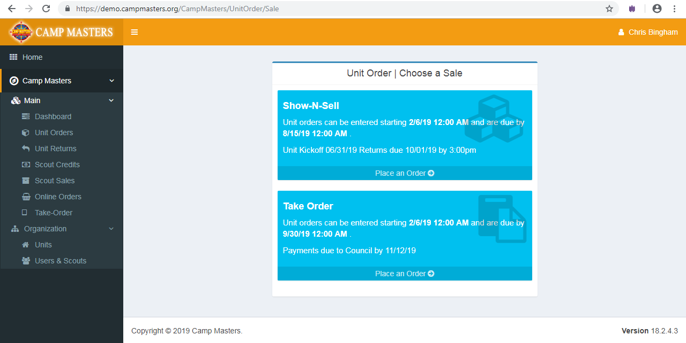
Click “Place an Order” on Sale Type to be entered
Make sure to click CORRECT SALE TYPE!

Slide 11
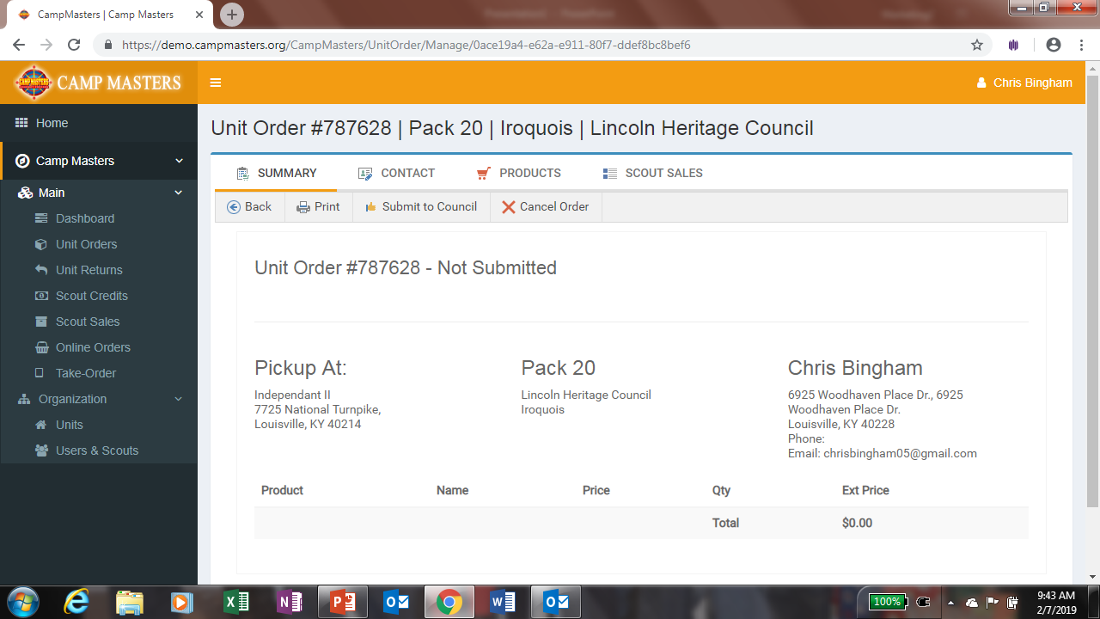
Click “PRODUCTS - available products for sale type will populate on the screen

Slide 12
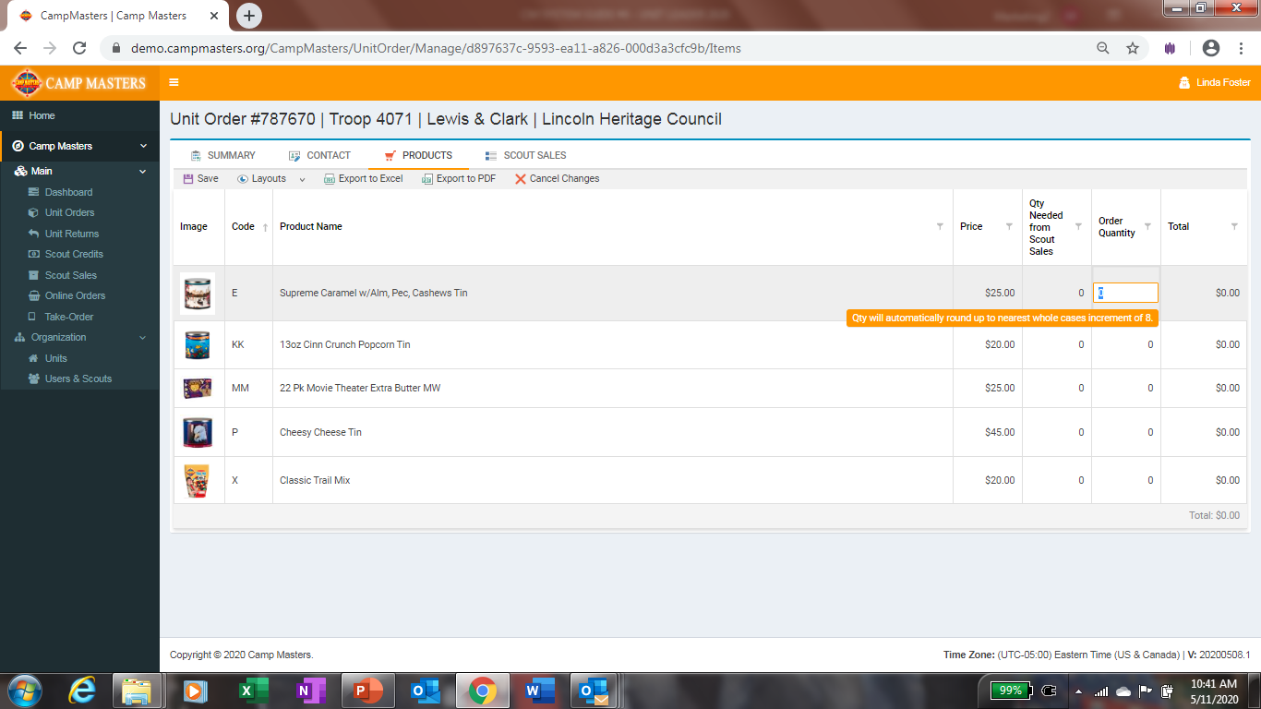
Must be entered in container quantities equal to full cases.
Click Save when finished with order.

Slide 13
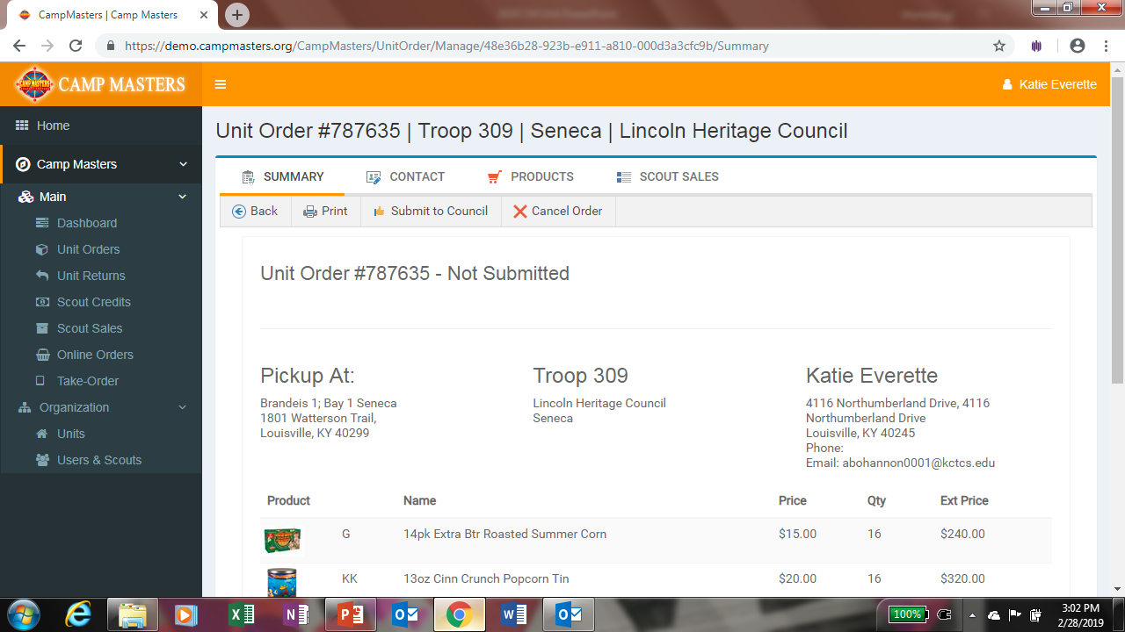
Once Order is complete and saved, Click “SUMMARY” to review.
Click “Submit to Council”
You can print a copy for your records from here.

Slide 14
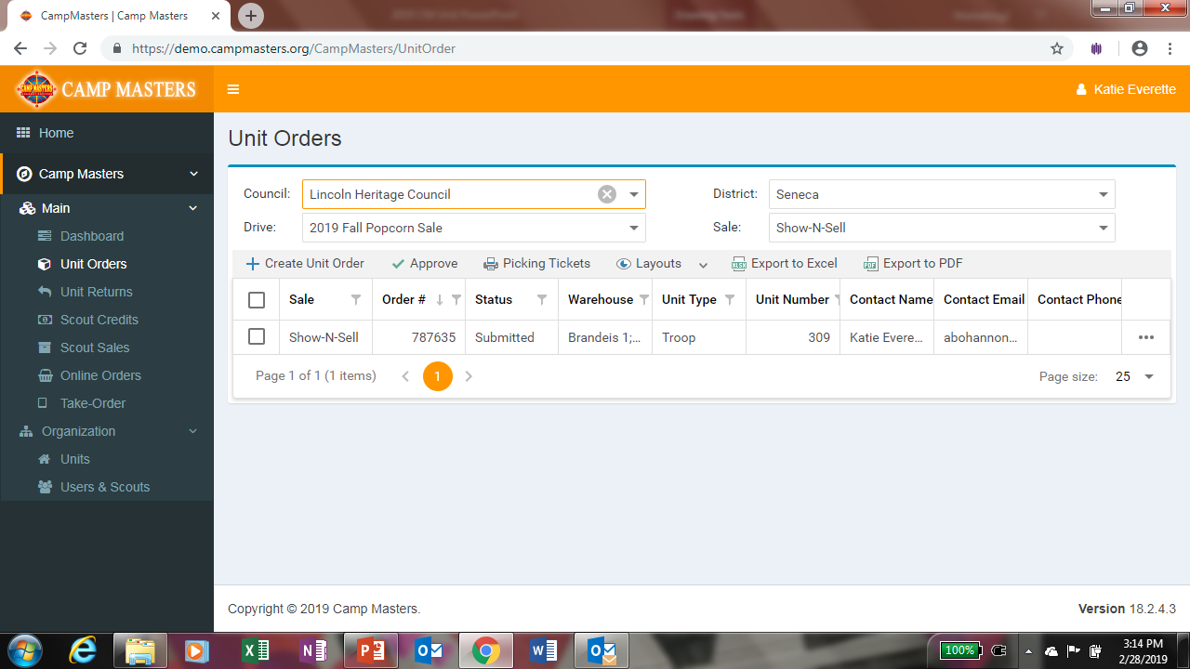
If you need to make changes to your submitted order, go back to your Dashboard and click “Unit Orders”. Screen will show all orders; click order# to be changed. This will open the order to allow changes. ANY CHANGES MUST BE MADE BEFORE “UNIT ORDER DUE” DATE

Slide 15
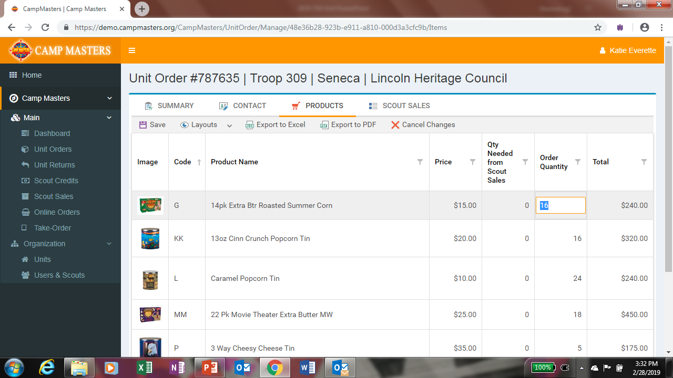
Click product to be changed. Once order is revised, click on “Save” then click on “SUMMARY”

Slide 16
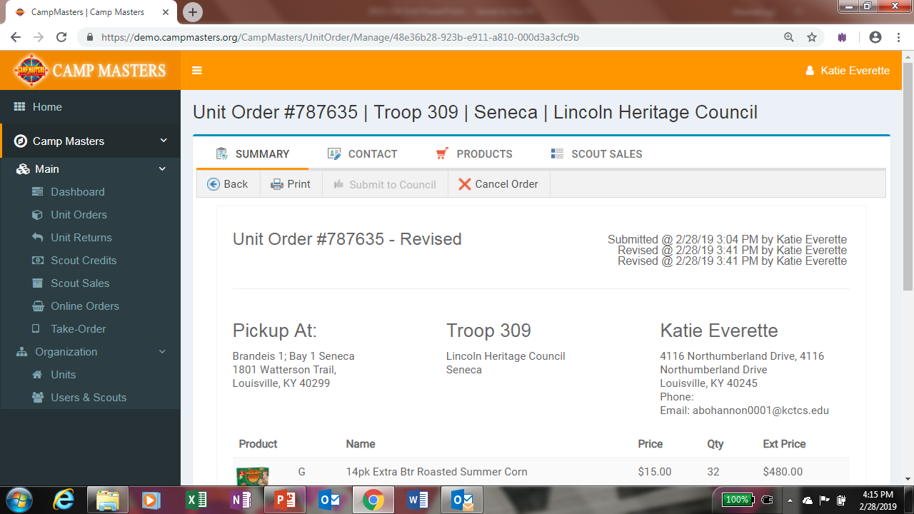
From the Summary page print your Revised Order for your records.

Slide 17
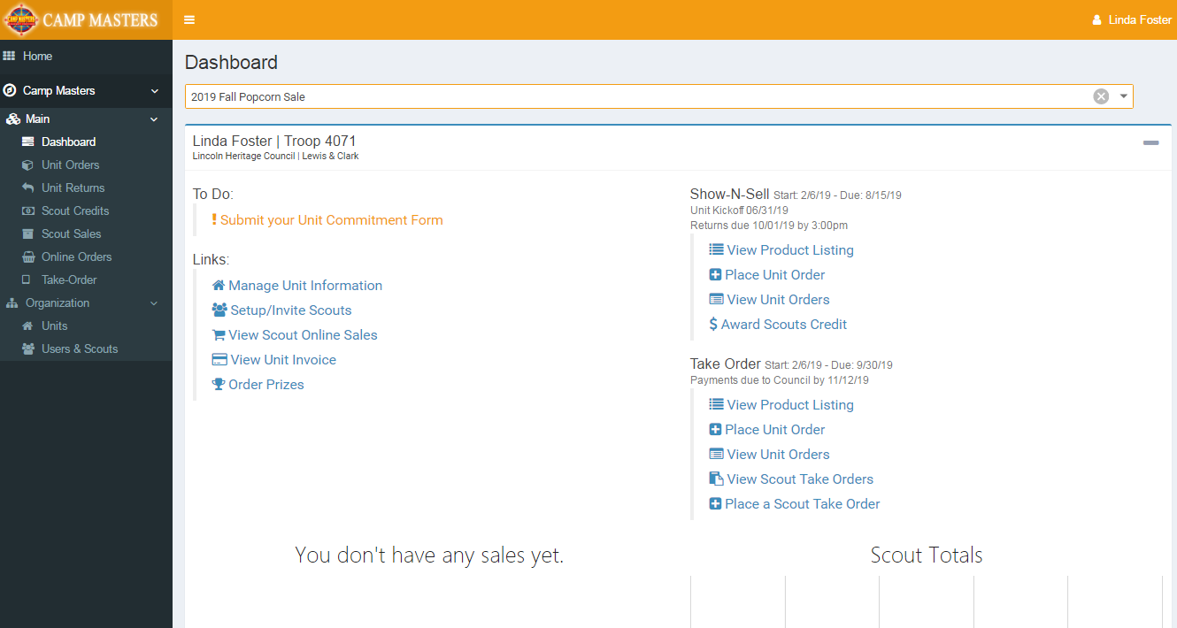
1. TAKE ORDERS CAN BE ENTERED AT THE SCOUT LEVEL – EITHER BY THE LEADER OR BY THE SCOUT
2. If UNIT is not entering at the Scout Level, Click “Place Unit Order”
2.
1.

Slide 18
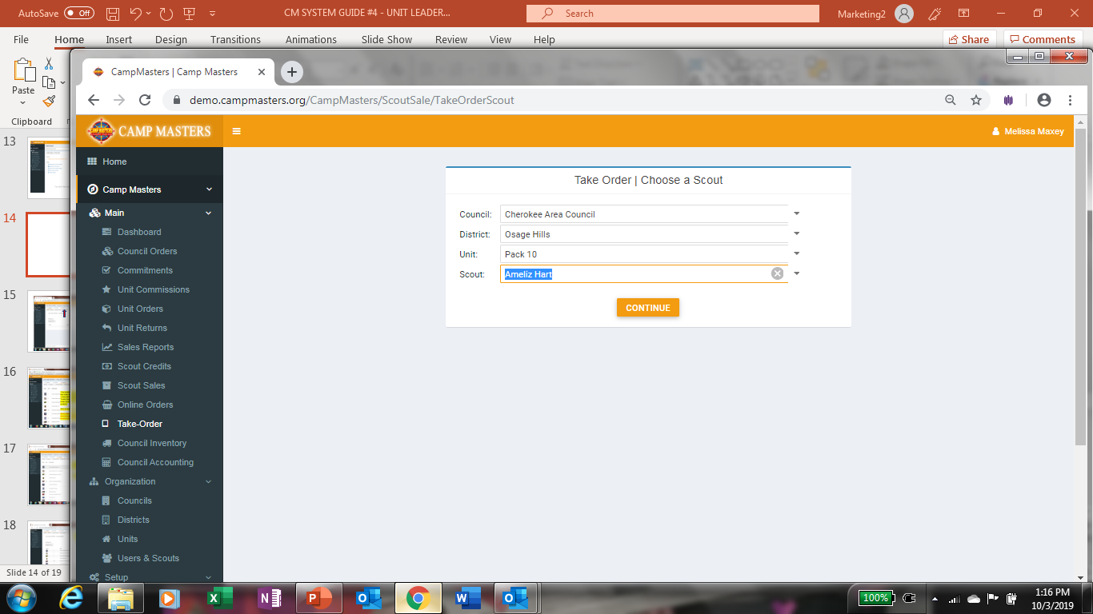
Select your Scout from the Drop down to enter their Take Order.

Slide 19
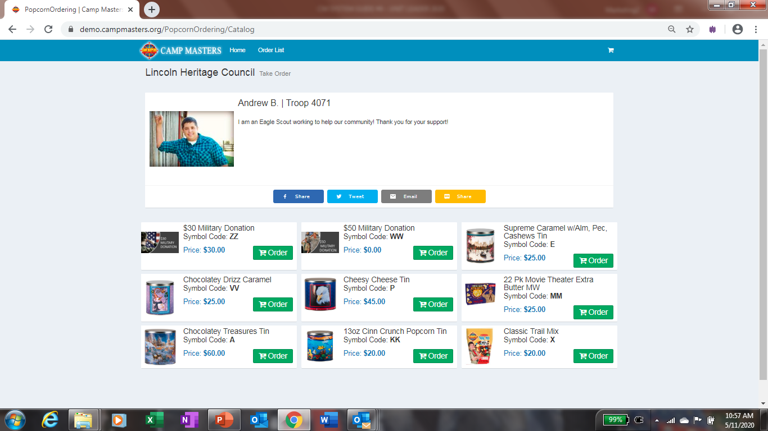
Enter the quantities for each product from the Scouts Take Order form.

Slide 20
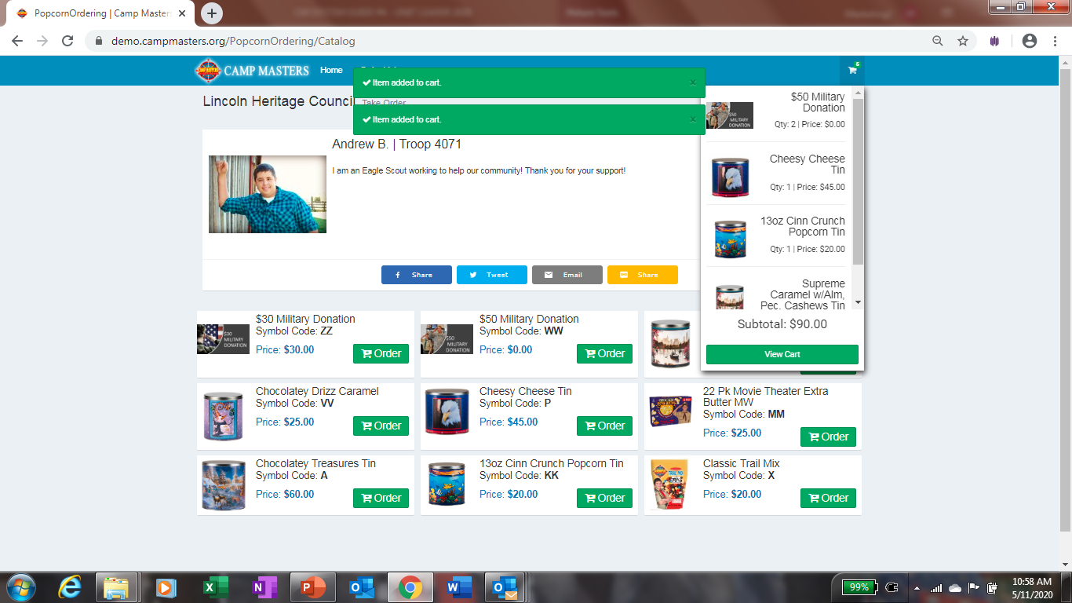
Once all quantities are entered, click on View Cart

Slide 21
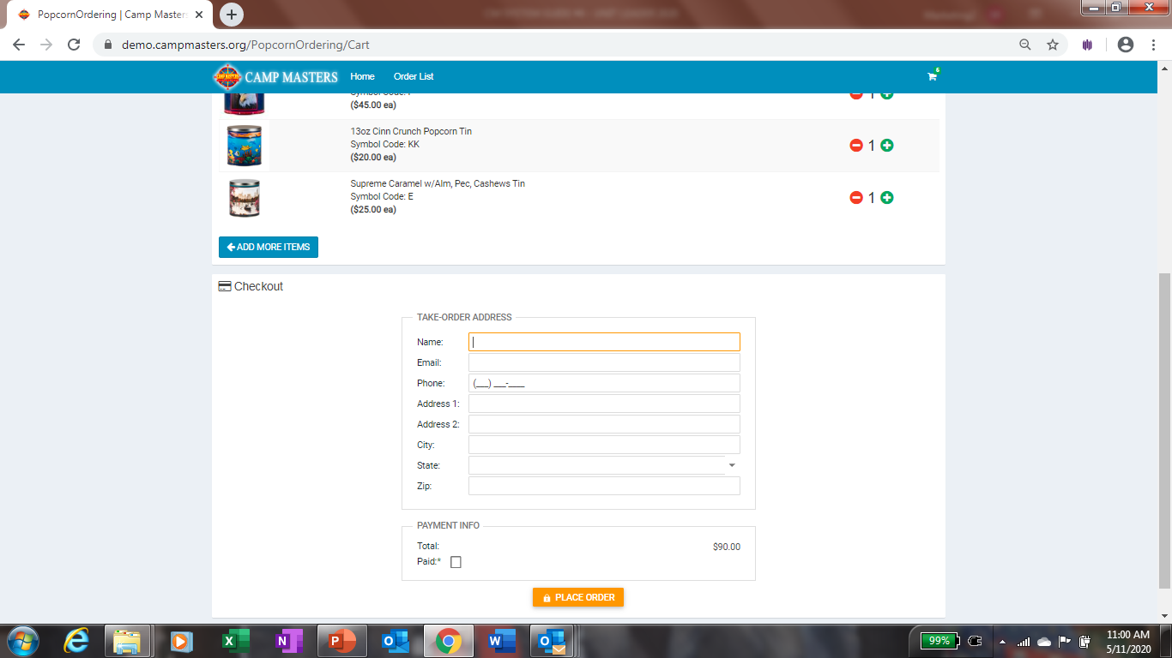
Enter Scouts information at the bottom. Then click place Order. You will do this for each Scout. When you are ready to place the Unit Take Order, your Scout quantities entered will show up in the Column “Qty Needed for Scout Sales”

Slide 22
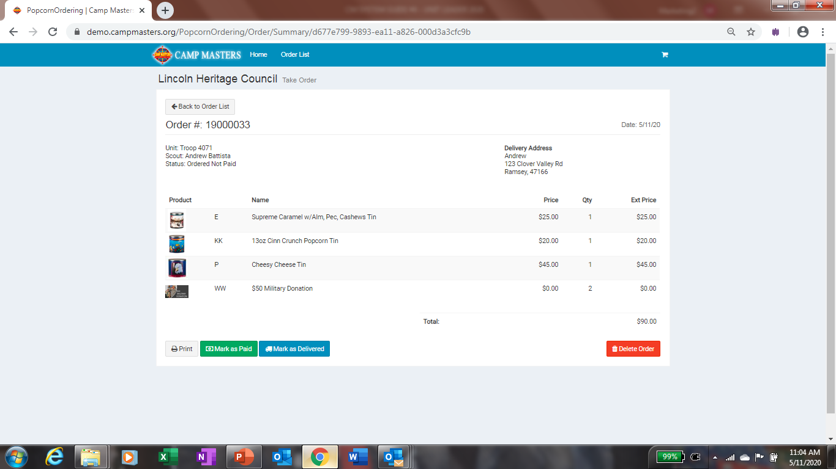
You can verify Scout Take Order is correct and print copy from here. If you need to make changes, click on “Back To Order List”

Slide 23
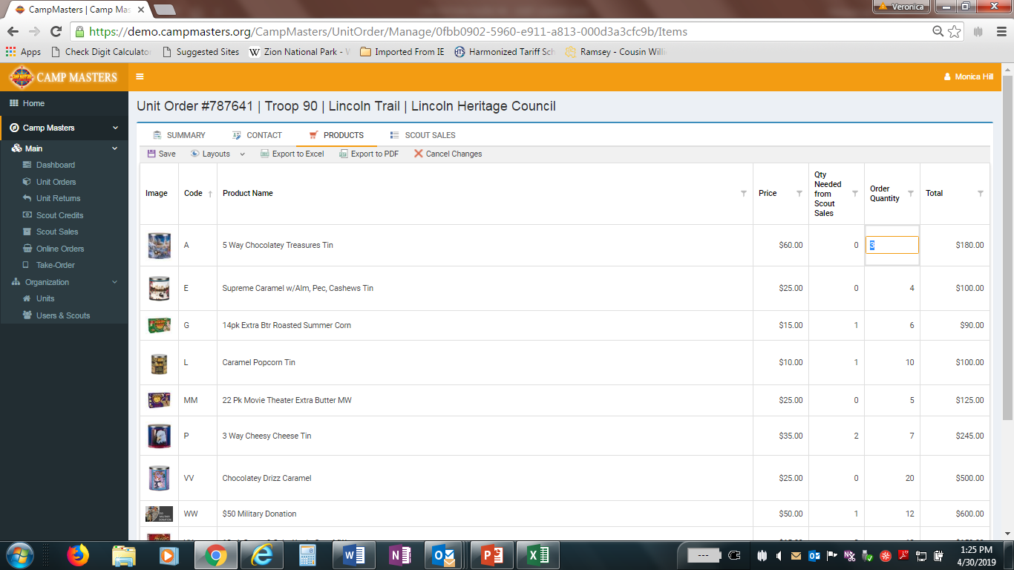
“Qty Needed from Scout Sales” will populate based on any order a Scout has submitted electronically (see “Scout Sales” top of Dashboard).
“Order Quantity” column can be adjusted for Take Order to account for any Unit inventory/ leftover product.
After all quantities are entered & adj, click “SAVE”
Scout Take Order quantities will appear in “QTY NEEDED from Scout Sales”. Do not adjust this number unless Scout has an order marked as delivered. You would then decrease order quantity.

Slide 24
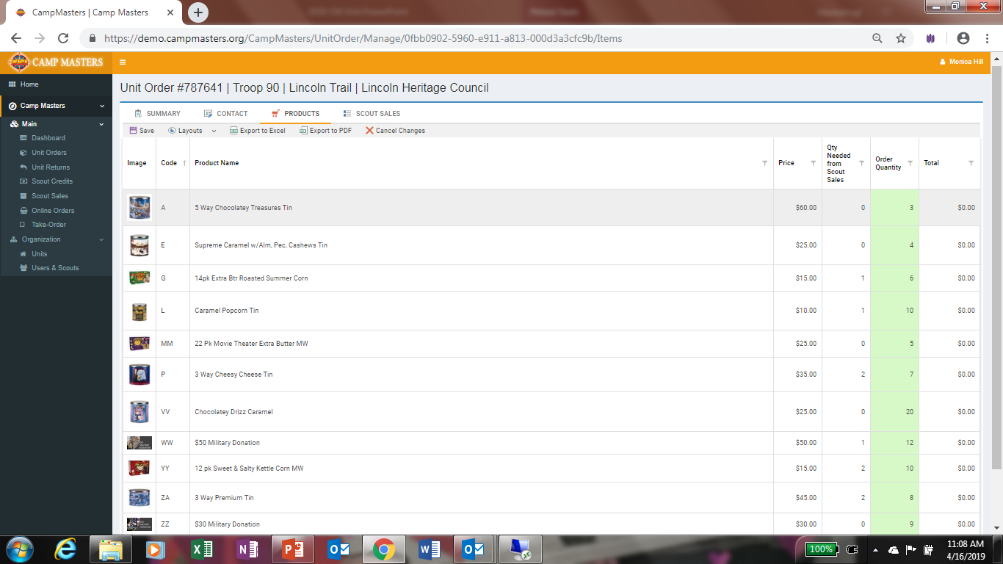
Click “Save” when complete. Be sure to review quantities and total dollars ordered.
Once Order is complete and saved, Click “SUMMARY” at top above “Save” to review.

Slide 25
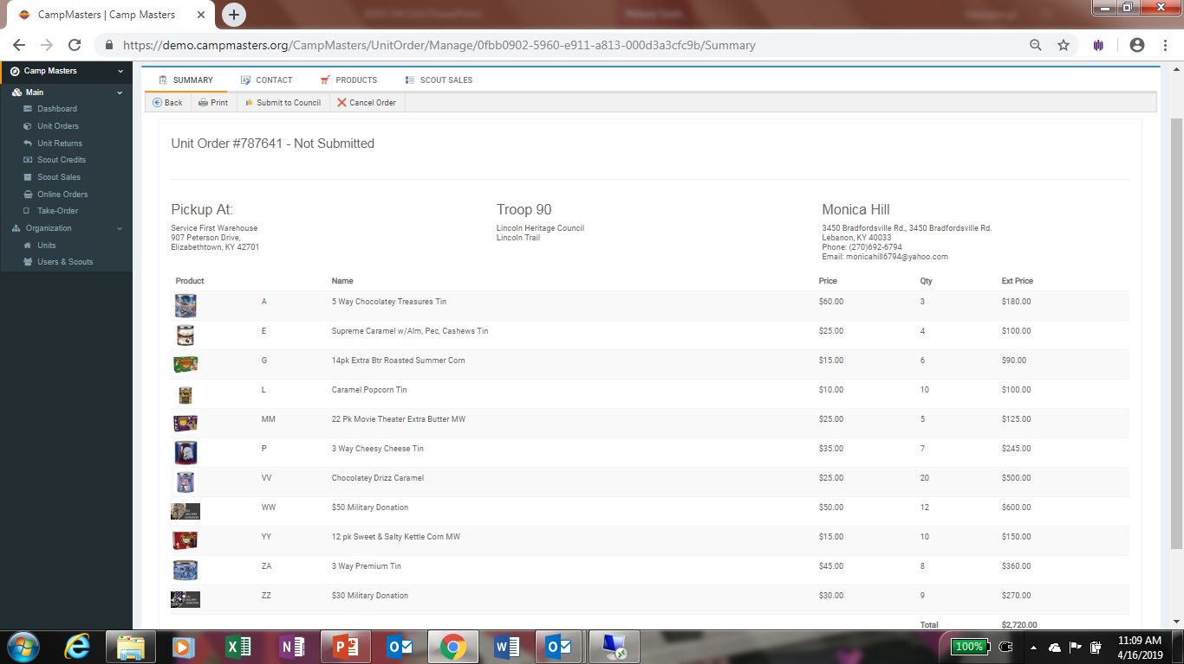
View of “SUMMARY” order.
Click “Submit to Council”
You can print a copy for your records from here.
If you need to make changes to your order, see instructions on pg. 13-15.

Slide 26
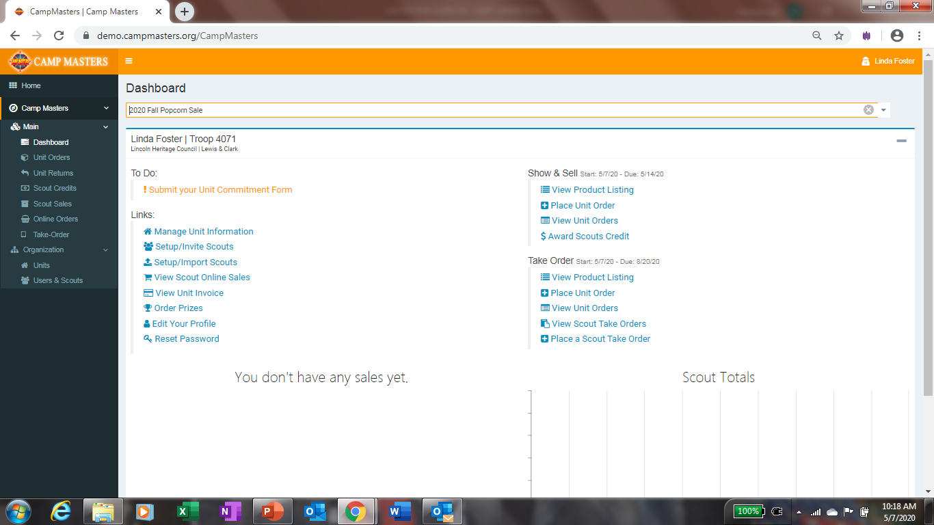
UNIT LEADER DASHBOARD/HOME PAGE BELOW.
FOR SCOUTS AND SCOUTING FAMILIES TO SELLONLINE AND ENTERING SCOUT TAKE ORDERS, REFERENCE
“CM SYSTEM GUIDE #5 – SCOUTS 2020”
BOTH GUIDES WILL BE AVAILABLE ON THE CAMP MASTERS WEBSITE – www.campmasters.org “HOW TO ORDER POPCORN”

