Slide 1
Welcome to Pack 123 Popcorn Kickoff !!
Notes:
Customize for your unit: Change “Pack 123” to your unit information.

Slide 2
It’s going to be an AWESOME Year !!
This year, our Pack is
planning to:
Activity One Date One
Activity Two Date Two
Activity Three Date Three
Activity Four Date Four
Notes:
Customize for your unit: Add the activities your unit plans to do this year.

Slide 3
How are we going to do all this fun stuff?

Slide 4
By Selling CAMP MASTERS Popcorn!!!!

Slide 5
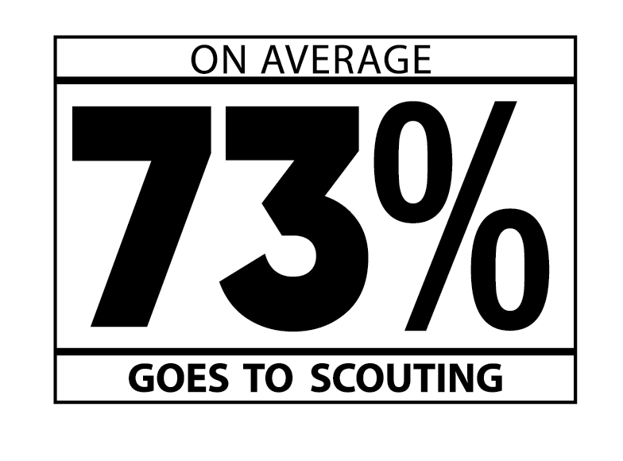
Why CAMP MASTERS Popcorn?

Slide 6
Why CAMP MASTERS Popcorn?
It’s EASY TO SELL & people LOVE to Support Scouts by purchasing delicious
CAMP MASTERS Popcorn

Slide 7
Why CAMP MASTERS Popcorn?
You will earn GREAT PRIZES!!

Slide 8
Prizes!!!
Why CAMP MASTERS Popcorn?
Earn Amazon Gift Cards and buy the prizes you want by selling popcorn this year!

Slide 9
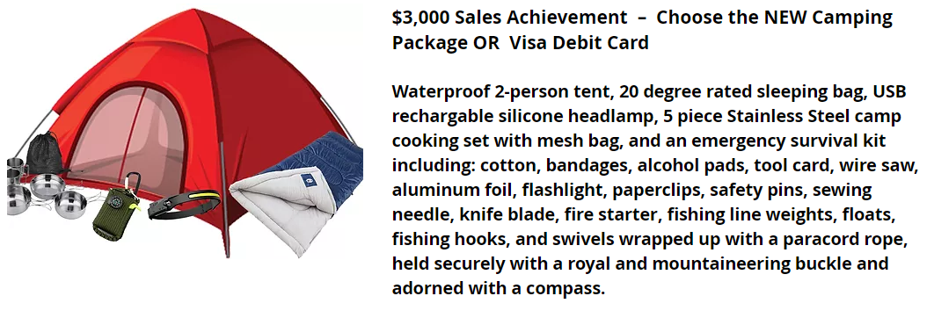
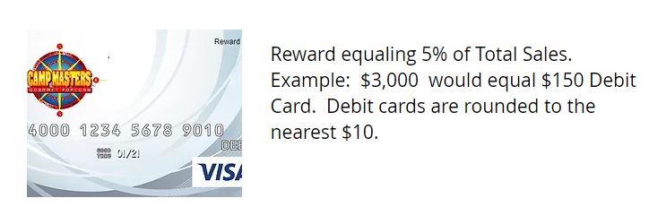
High Achiever Prizes
from
CAMP MASTERS!!!
Sell $3,000 or more and earn a Camping Package or Visa Rewards Card for 5% of your Total Sale

Slide 10
Unit Prizes!!!
Pack 123 Incentives
Top Selling Scout Prize
Top Selling Den Prize
Sell $________ and throw a pie in your Leader’s face!
Notes:
Customize for your unit: Add your Pack/Troop’s incentives, like a reward for the Top Selling Scout or a bonus prize for the Top Selling Den.

Slide 11
Council Prizes!!
Council Incentives
Sell $1,500 to earn an invite for a special party & a chance to win an Amazon Gift Card for up to
$1,000!
The more you sell, the more chances you have to win multiple gift cards!
Saturday, December 3, 2022
Check-In: 10:00 am
Drawing: 11:00 am
(Must be present to win)
Scouts also receive:
Incredible Pizza Buffet & Drink
$5 Game Card
Notes:
Customize for your unit: Does your Council offer special Popcorn Sale Incentives? If so, be sure to include them here.

Slide 12
Our Sale!!!!

Slide 13
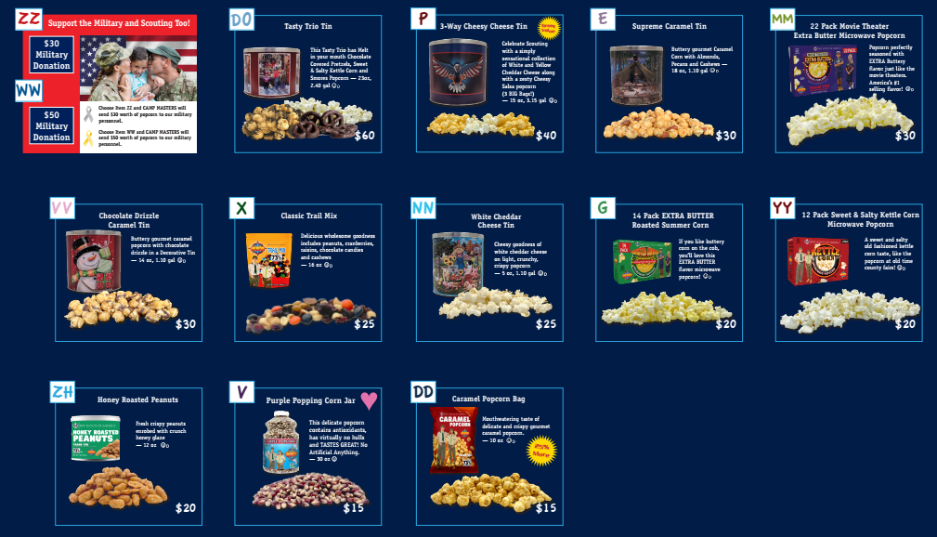
What we’re selling
Product
Lineup

Slide 14
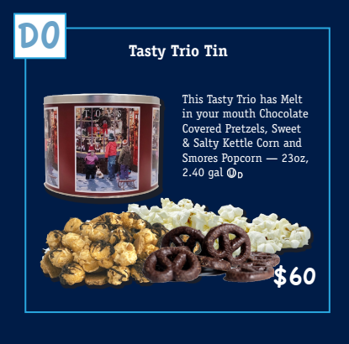
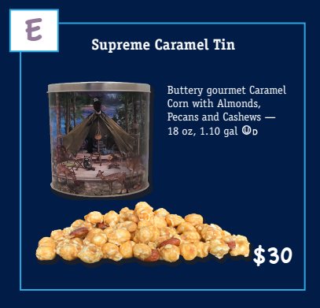
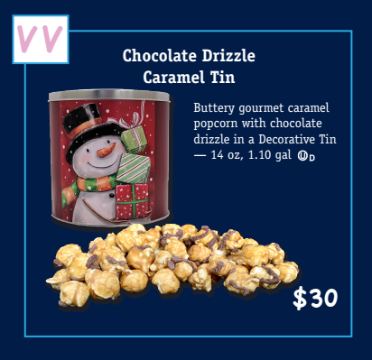
NEW this Year
New product!
Was in a Bag last year – Tin makes a great Christmas Gift!
Was in a Bag last year – Tin makes a great Christmas Gift!
Notes:
Customize for your unit: Use this slide to describe new products your unit will be selling this year. Educate Scouts and their families so they’ll be ready to tell consumers about the popcorn.

Slide 15
How to sell…
Show-and-Sell
+
Take Order
+
Online

Slide 16
Show & Sell Locations
Enter Show and Sell Dates and Locations to
get Scouts confirmed
You could also have a signup sheet in the room or download the SignUpGenius App to use for signups

Slide 17
How to sell…
How to sell…
Scout Demonstration
“Hello sir / ma’am, my name is __________,
and I’m a scout with Pack /Troop_____. We’re selling popcorn to help raise money for our Pack / Troop. You can help us by buying some of our delicious popcorn.
You’ll help us out, won’t you?
Notes:
Invite two Scouts to the front of the room to role play a consumer and selling Scout.

Slide 18
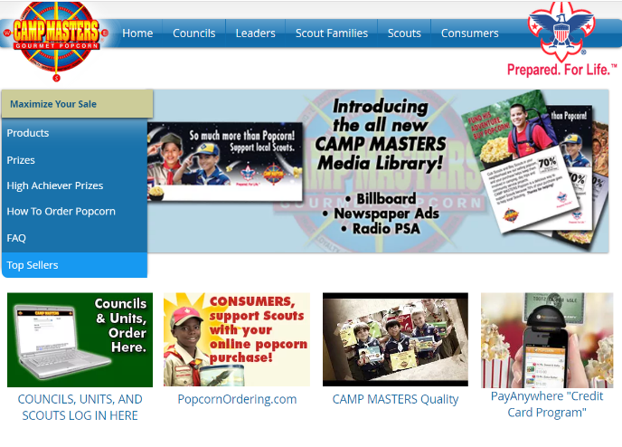
Self Register to Sell Online…
Scouts can Self-Register to sell online at www.campmasters.org
Click here
Notes:
Invite two Scouts to the front of the room to role play a consumer and selling Scout.

Slide 19
Sell Online…
Any Scout that sells $400 online will receive a $10 AMAZON Gift Card
All online Scout Sales count towards CAMP MASTERS High Achiever Prizes, Prize Program and Council Prizes
Notes:
Customize for your unit: Use the Popcorn Planner to determine your unit’s sales goals and then the individual Scout goal.

Slide 20
Our Sale
Our Sales Goals this Year
• Unit Sales Goal: $______
• Scout Sales Goal: $______
Notes:
Customize for your unit: Use the Popcorn Planner to determine your unit’s sales goals and then the individual Scout goal.

Slide 21
Scouts, what’s your GOAL ?
Our Sale

Slide 22
Our Sale
Important Dates
Our sale starts _______ and ends _______.
Show & Sell dates are _____ at __________ and _____ at _____________ .
Orders are due _______________.
Popcorn Pick Up is _____ at ___________ .
Notes:
Customize for your unit: Enter your unit’s important dates here.

Slide 23
Our Sale
Here’s what you’re getting tonight…
Family Guide that includes the Order Form & Prize Forms
Council Incentive Sheets
Product Samples
Etc.
Notes:
Customize for your unit: Be sure to tell families what they’re getting tonight at the popcorn kickoff. In addition to the order forms, prize forms and the family page, are there other handouts?

Slide 24
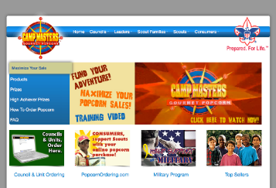
Our Sale
Do you have questions or want to learn more?
Contact our Popcorn Kernel
Name and Phone
For tips, tools & product
information go to
www.campmasters.org
Notes:
Customize with your unit’s Popcorn Kernel’s name and contact information.

Slide 25
Thank you and have a GREAT SALE !!
Our Sale
Notes:
Customize for your unit: Change “Pack 123” to your unit information.

